Slide 1




TAM4MTM: A Phase 1/2 Randomized, Placebo-Controlled, Double-Blinded, Single Crossover Study to Determine the Safety and Efficacy of Tamoxifen Therapy for Myotubular Myopathy (XLMTM)
GIOVANNI BARANELLO
The Dubowitz Neuromuscular Centre
UCL Great Ormond Street Institute of Child Health
London

Slide 2
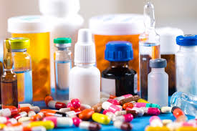
What is drug repurposing/repositioning?
  A broad term covering medicines that are approved, and used “as-is” or reformulated for the new indication
  Promise of providing safe, timely, and affordable access to new treatment options for patients with unmet medical needs.

Slide 3
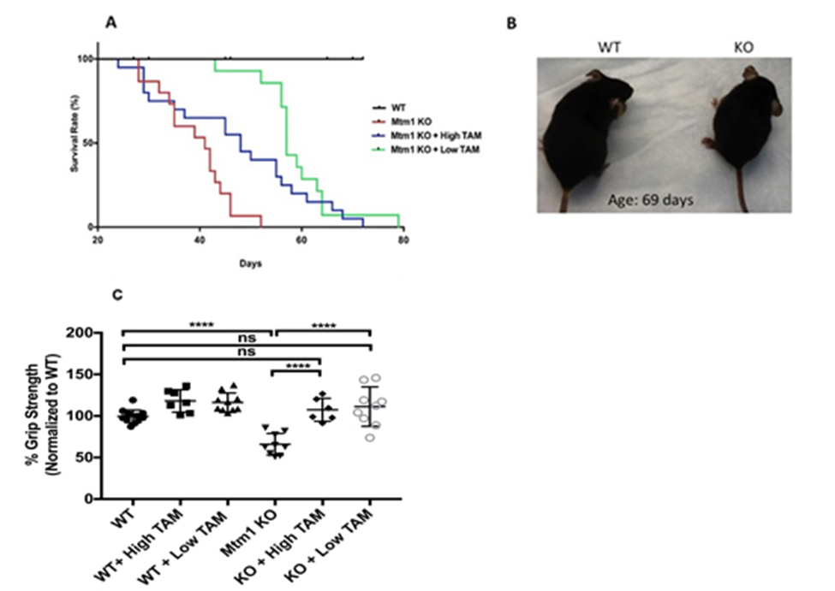
Why Tamoxifen?
Animal studies have shown that tamoxifen treatment in MTM KO mice extends lifespan, increases grip strength, and improves muscle histopathology
Tamoxifen acts via the oestrogen receptor pathways
Also by modulating Dynamin 2 (DNM2) protein levels – a key XLMTM disease modifier
(Sabha, 2016; Maani, 2018; Gayi, 2018)

Slide 4
Hypothesis
tamoxifen treatment can improve motor and respiratory function in MTM patients
To be used as stand-alone (when patients cannot receive other upcoming treatments) or in combination

Slide 5
Sites involved
SickKids, Toronto
National Institutes of Health, Washington
Ann and Robert H. Lurie Children's Hospital, Chicago
Great Ormond Street Hospital, London

Slide 6
Primary Objective:
1. To assess the safety and tolerability of tamoxifen therapy in males with XLMTM
2. To determine the efficacy of tamoxifen therapy to improve motor function in males with XLMTM

Slide 7
Secondary Objectives:
To determine whether respiratory function improves with tamoxifen therapy,
To determine whether there is continued improvement with longer treatment periods of tamoxifen (3 months vs 6 months).
To determine whether there are carry-over effects after cessation of tamoxifen treatment.
To assess miR-133a as a biomarker for MTM

Slide 8
Study details
randomized, double-blinded, single crossover clinical trial
16 patients to recruit (4 at GOSH)
study duration 36 months

Slide 9
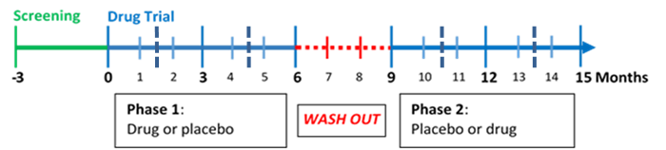
An external DSMB will examine safety data and PK/PD data at different time points (t = 3, 6, and 12 months)

Slide 10
Inclusion criteria
Male
Patients ages 2-18 years may participate.
MTM resulting from a confirmed mutation in the MTM1 gene
written informed consent
Willing and able to comply with all protocol requirements and procedures.

Slide 11
Exclusion criteria
Other disease which may significantly interfere with the assessment of MTM and is clearly not related to the disease
Surgery or hospitalization < 3 months before starting TAM4MTM, or has surgery scheduled during the 18 months of participation
History of thromboembolic events
History of thrombocytopenia or coagulopathy
Severe liver dysfunction, as defined by: ongoing hyperbilirubinemia CTCAE v5.0 grade 3 or above; ongoing elevated liver enzymes (AST, ALT or γ-GT) CTCAE v5.0 grade 3 or above (> 5.0X ULN)
Pathogenic or likely pathogenic mutations in ABCB11, or has been diagnosed with benign recurrent intrahepatic cholestasis type 2 (BRIC2) or progressive familial intrahepatic cholestasis type 2 (PFIC2)
Currently enrolled in a treatment study for XLMTM or receiving treatment with an experimental therapy other than pyridostigmine.
Treatment with pyridostigmine for < 6 weeks duration
Use of concomitant medication known to inhibit CYP2D6 and/or CYP3A4, including clarithromycin, erythromycin, diltiazem, itraconazole, ketoconazole, ritonavir, verapamil, goldenseal and grapefruit, paroxetine, troleandomycin, rifampin, phenobarbital, aminoglutethimidine, medroxyprogesterone, amiodarone, haloperidol, indinavir, ritonavir, quinidine, rifampicin, or any selective serotonin reuptake inhibitor (SSRI).
Contraindication to tamoxifen or its ingredients

Slide 12
Schedule of activities
Motor function
Respiratory Function
Growth and Vital Signs
Physical Exam
Safety Measures – Blood work
6. Ophthalmological Assessment
7. Electrocardiogram
8. Abdominal Ultrasound
9. Quality of Life questionnaire
10. Tamoxifen Pharmacokinetics
11. Biomarker

Slide 13
Potential Risks and Benefits
Tamoxifen is generally a well-tolerated drug
The study protocol incorporates many safety measures to monitor for adverse events that have been documented with tamoxifen use
The dose used is based on dosing used for other studies and it is also the same dosage used in 2 DMD studies
As there are no treatments presently available for MTM, and given the lethality rate of common co-morbidities such as respiratory infections, there is still an unmet need for primary or adjunct therapies to gene therapy and enzyme replacement therapy, which are in development for MTM
The benefits of tamoxifen use outweigh the risks.

Slide 14
Process for identifying and recruiting patients at GOSH
randomisation system to identify and select patient that would potentially be eligible based on inclusion/exclusion criteria
clinicaltrials.neuromuscular@gosh.nhs.uk

Slide 15
Timeline
Ethics approval received
Contract with SickKids signed off
MHRA submission (July 2021).
As there were no reactions observed in this population
Request of reference safety information (RSI) (list of expected events that have occurred more than once, have been determined as related to the use of the tamoxifen, and identified as “serious”)
Recruitment started in Canada
  2 patients recruited
  Joint review from PIs after 4 weeks of treatment
  Safety review for the 2 patients
  Green light to proceed with recruitment of 3rd patient

Slide 16
Thanks for the support to
Anne Lennox
Wendy Hughes
Melanie Spring

