Slide 1
Family Meeting
November 27, 2021

Slide 2
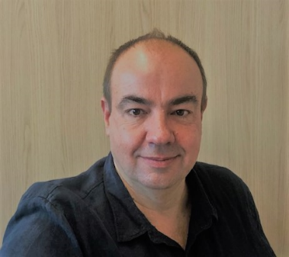
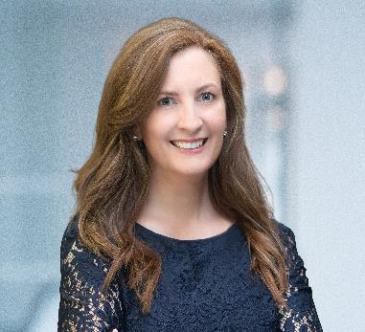
Joining you today
Chris Freitag
Chief Medical Officer
Lori McKenna Gorski
Patient Engagement

Slide 3
Our Agenda
Who we are
Overview of UNITE-CNM
  Design; Eligibility; Progress
Your questions
Open Q&A
What to expect next

Slide 4
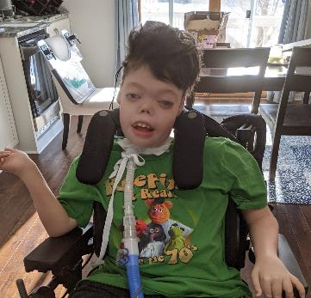
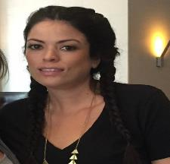
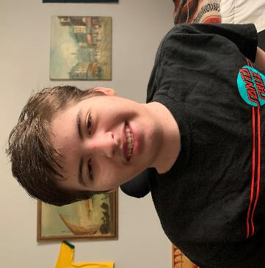
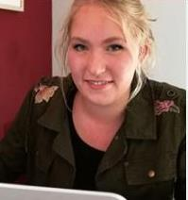
Our Focus: Changing the Lives of Patients with Myotubular and Centronuclear Myopathies (CNM)
X-linked Myotubular Myopathy patients (MTM1)
Autosomal Dominant CNM patients (DNM2)
Declan
Ashley
Sebastian
Lynn

Slide 5



‘UNITE – CNM’: Phase 1 / 2 study of DYN101, first patient dosed Q1 2020 – IV 1/week
OPTIMAL DOSE
Target engagement
Efficacy 12w
Broadest development plan for any investigational product in CNM
Evaluating safety, tolerability, PK & efficacy of DYN101
DYN101 – C101
Phase 1-2
Safety/tolerability/PK
SAD/12 wks MAD
≥ 16 y
n = 18 (MTM1 & DNM2)
EXTENSION study
12 wks → signs of efficacy
Natural History Study
Efficacy 24 w
Run-in
24 weeks treatment
5 domains
8 assessments
1. Muscle strength
grip
2. Muscle function
MFM32
3. Eating/swallowing
questionnaire
4. Respiratory function
pulm fct test and time on ventilatory support
5. Patient reported
QOL/GAS
Following Phase 1/2 studies, Dynacure plans to initiate a registration-directed program in EU & US

Slide 6
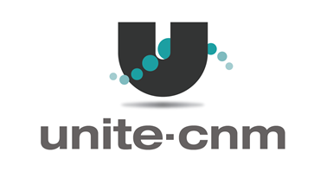
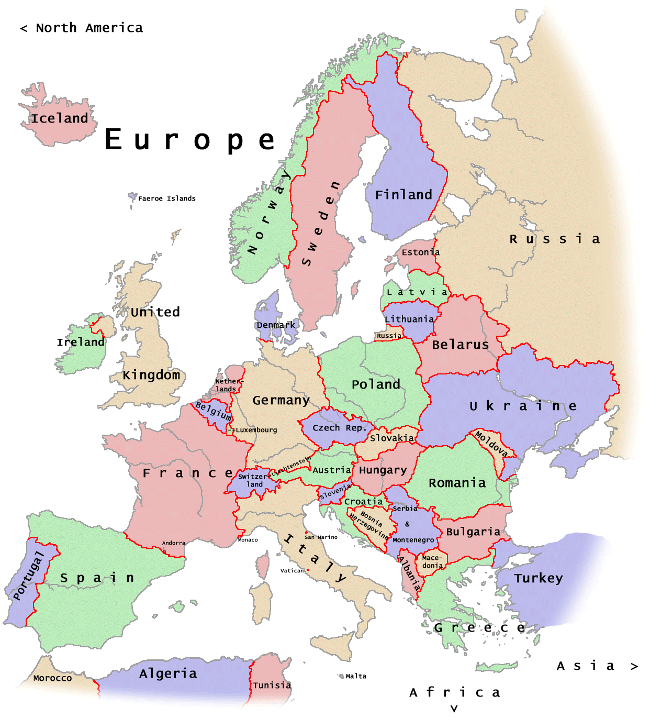
‘Unite-CNM’: opening 8 centers in 6 countries
Belgium
Antwerp: Dr. Baets
Denmark
Copenhagen: Dr. Vissing
France
Paris: Dr. Behin
Germany
Essen: Dr. Schara
Munich: Dr. Montagnese
Netherlands
Nijmegen: Dr. Voermans
UK
London: Dr. Quinlivan
Newcastle: Dr. Guglieri

Slide 7
Challenges of UNITE-CNM
Small number of patients
Eligibility: Patients must be able to execute the physical/respiratory assessments
COVID
“Post -COVID” absences
Emerging data on MTM1 patients
Protocol amendments

Slide 8
Questions from the Community
What is the status of the pediatric study?
Can I travel to different countries to participate?
When will I learn more?
What other questions?

Slide 9
Thank you

