Slide 1

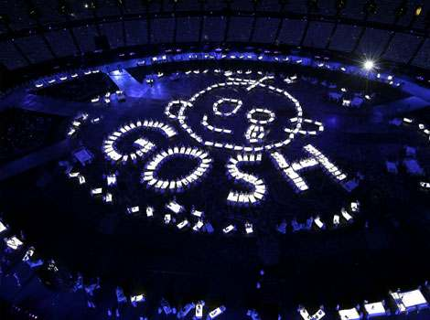
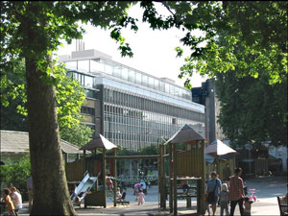
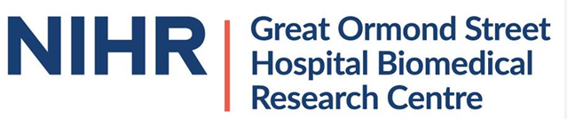
AAV gene therapy for neuromuscular disorders
Francesco Muntoni
Dubowitz Neuromuscular Centre
UCL Institute of Child Health
& Great Ormond Street Hospital
London, UK

Slide 2
Francesco Muntoni: disclosures
Duchenne
Clinical trials
CI of 4 antisense oligonucleotides clinical trials with Sarepta.
PI of Sarepta Phase III AAVrh74 microdystrophin
CI of MDUK/Genethon AAV8 microdystrophin
Natural history studies
PI of the MDUK funded UK North Star DMD network; and AFM funded iMDEX natural history study
Investigator initiated studies funded by Industry
PI of D-Brain, dystrophin restoration in mdx brain, funded by Sarepta
Spinal Muscular Atrophy
PI of Ionis/ Biogen antisense oligonucleotide nusinersen Phase III study
PI of Novartis AAV9 phase II and III trials in SMA I
PI of Roche risdiplam jewelfish study
Myotubular Myopathy
PI of AAV8 MTM1 gene natural history and gene therapy trial
Other financial disclosures
Member of Pfizer rare disease SAB
Ad-hoc SAB participation for Novartis, Biogen, Dynacure, Dyne Therapeutics, Roche, Sarepta therapeutics

Slide 3
Topic discussed
1. How does AAV gene therapy works
2. Common adverse events of AAV gene therapy
3. Recent events in the AAV gene therapy trial for MTM1

Slide 4
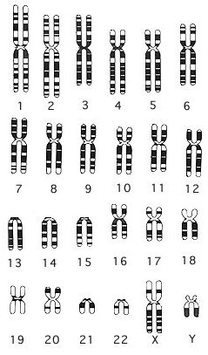
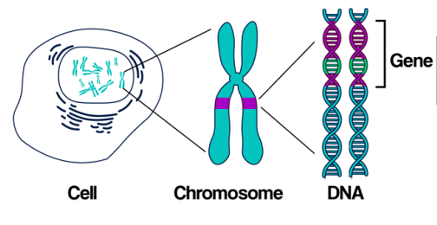
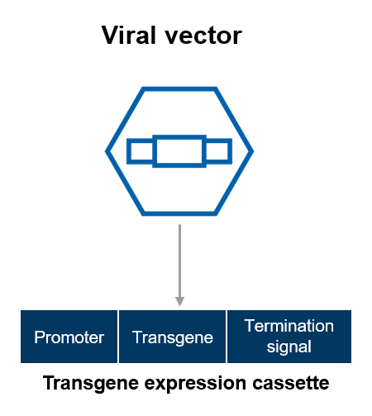
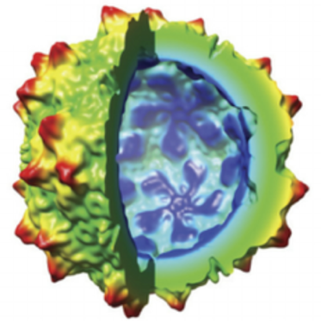
Each chromosome contains thousands of genes, located in the DNA
Each cell of our body has a copy of a chromosome from our father and one from our mother
Chromosomes
Restored production of defective protein
X
Defective gene

Slide 5

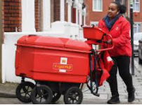
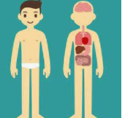
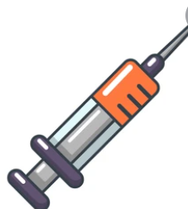
Recipe for AAV gene therapy preparation
Select an AAV virus that goes where you needed it (muscle/ heart/brain)
“Gut it” from the viral genetic material, so that the virus cannot replicate
Insert in the empty AAV “envelope” the gene of interest, together with switch-on command
Administer the AAV, typically by intravenous administration

Slide 6
How much “empty envelopes” we inject in people so that it reaches all the muscles?
A lot!
Approximately 40 times the amount used when we vaccinate someone against for example influenza
The good thing is that this virus cannot divide, i.e. cannot replicate inside the body
However this large amount of “envelope” can cause trouble as our immune system recognizes that there is a lot of this viral envelope around
As the liver is our “filter organ”, a very large amount of the viral vector gets trapped into the liver
This can cause significant problems to the liver

Slide 7
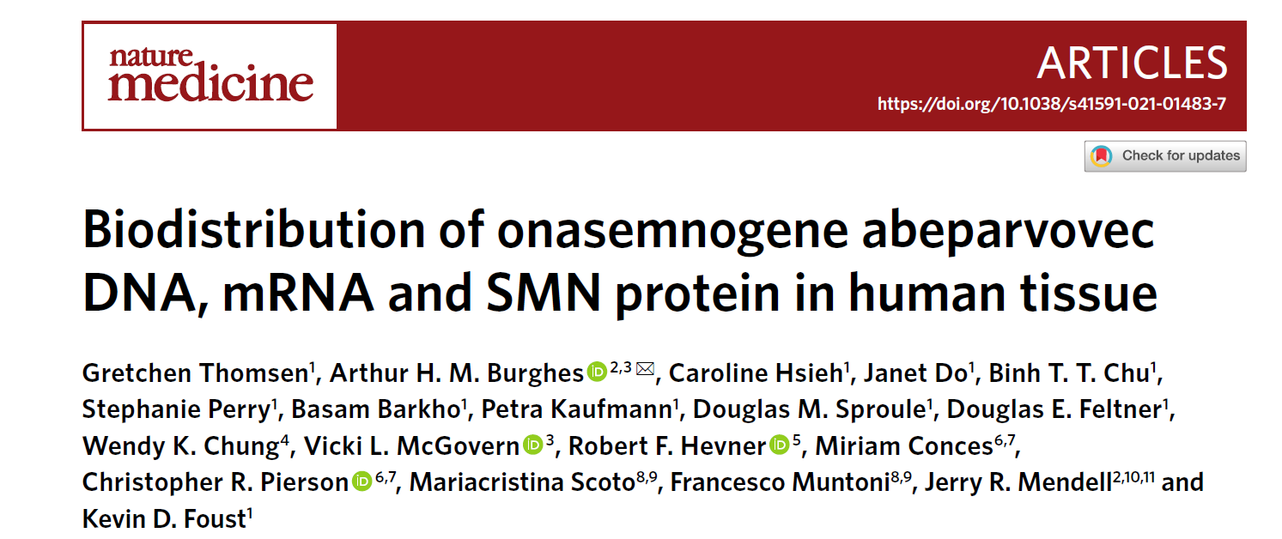
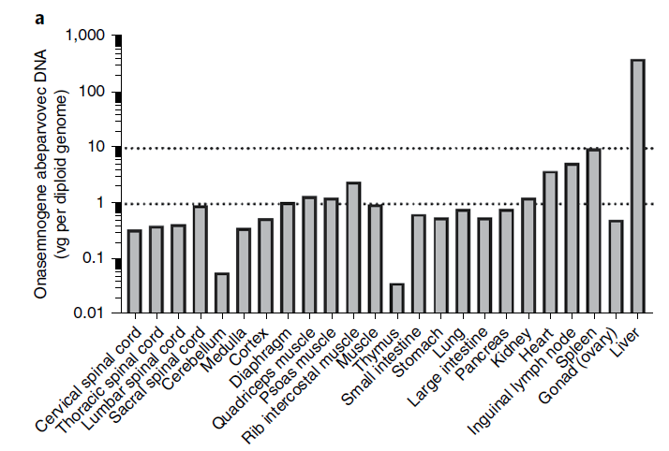

Slide 8
Timeline of adverse events in different AAV gene therapy programs
Nausea/ vomiting
Cardiac enzyme elevation
Liver involvement
Low platelets
1 month
2 months

Slide 9
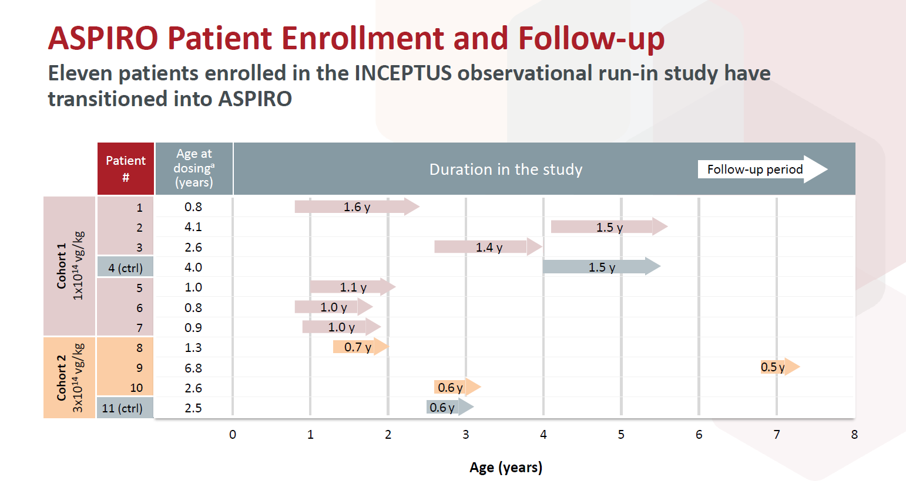

Slide 10
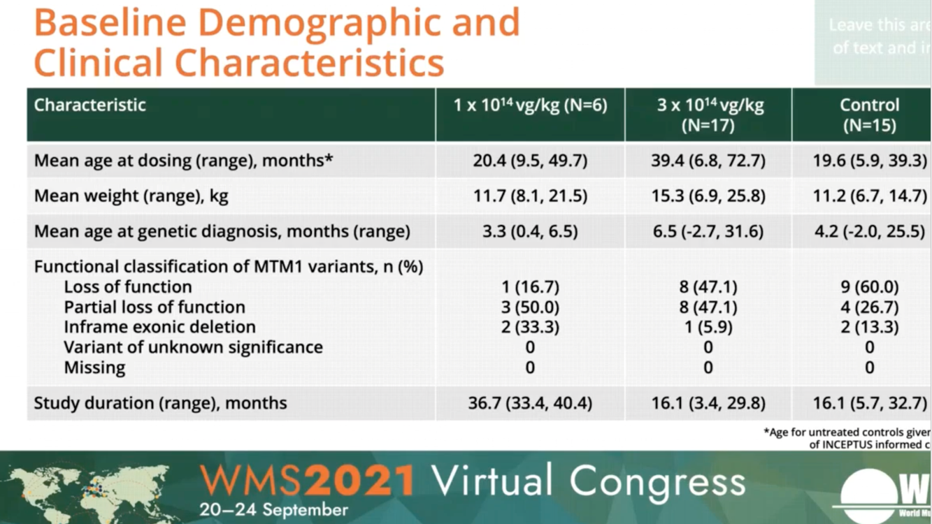

Slide 11
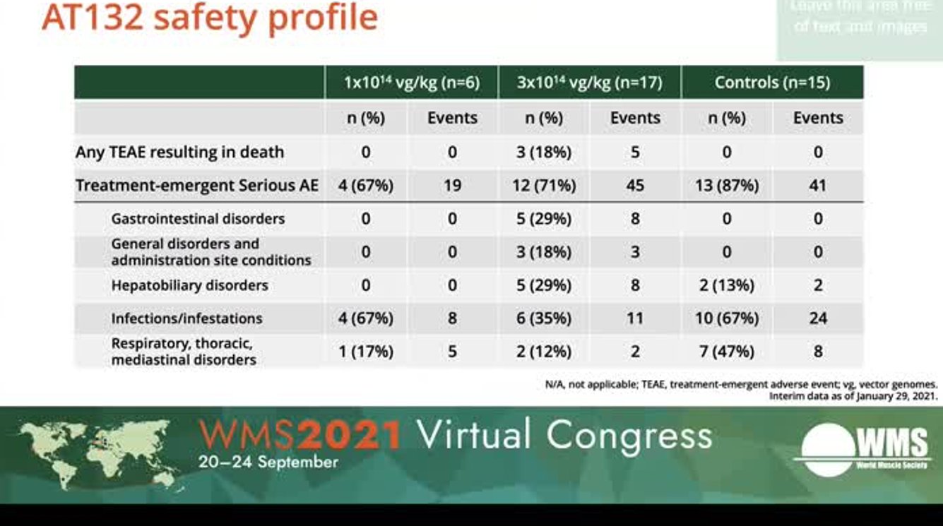

Slide 12
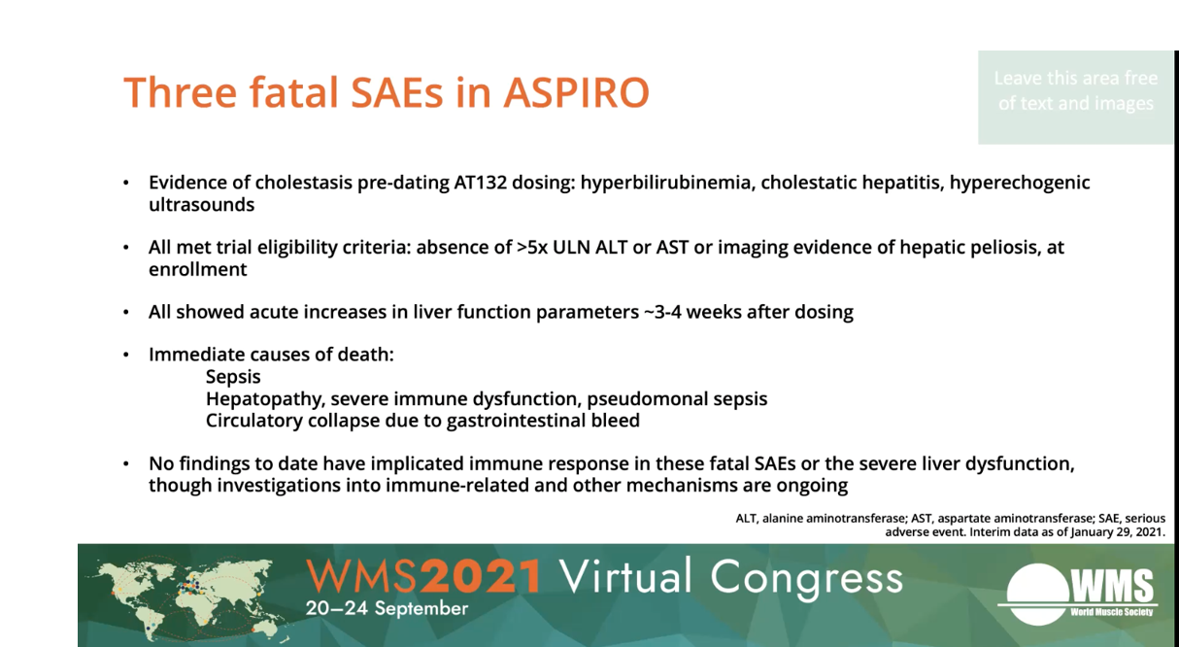

Slide 13
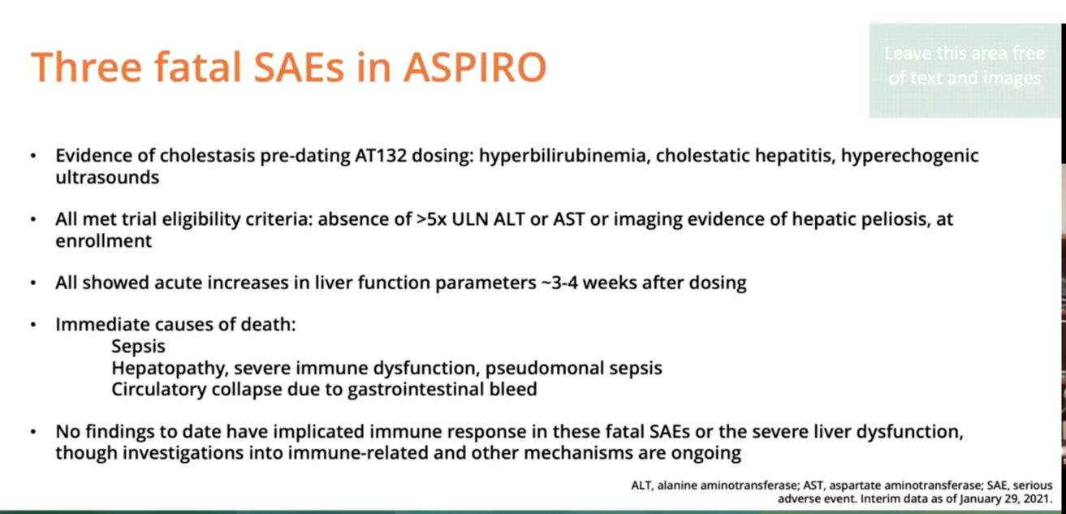

Slide 14
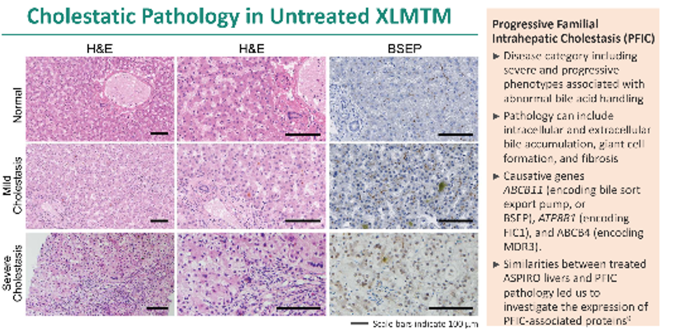
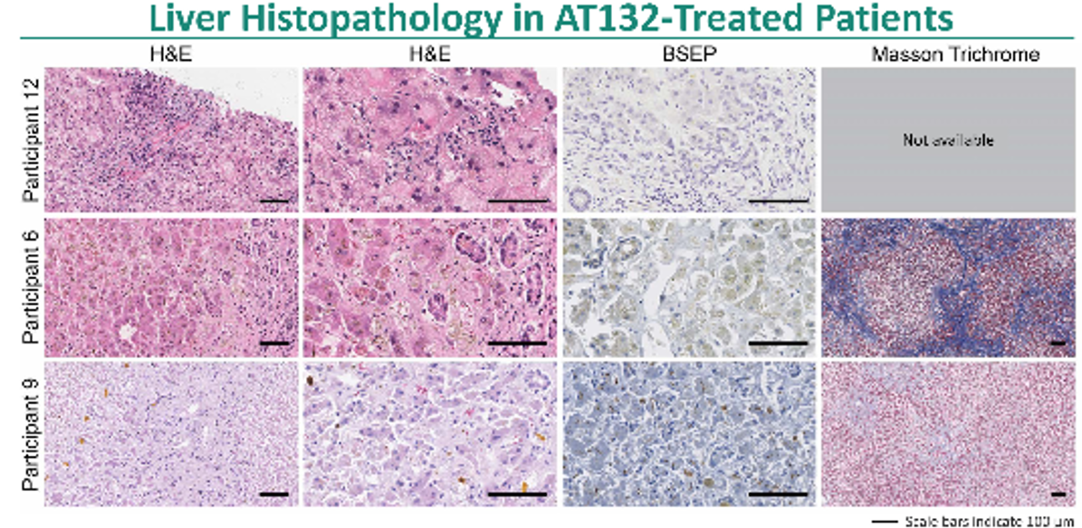

Slide 15
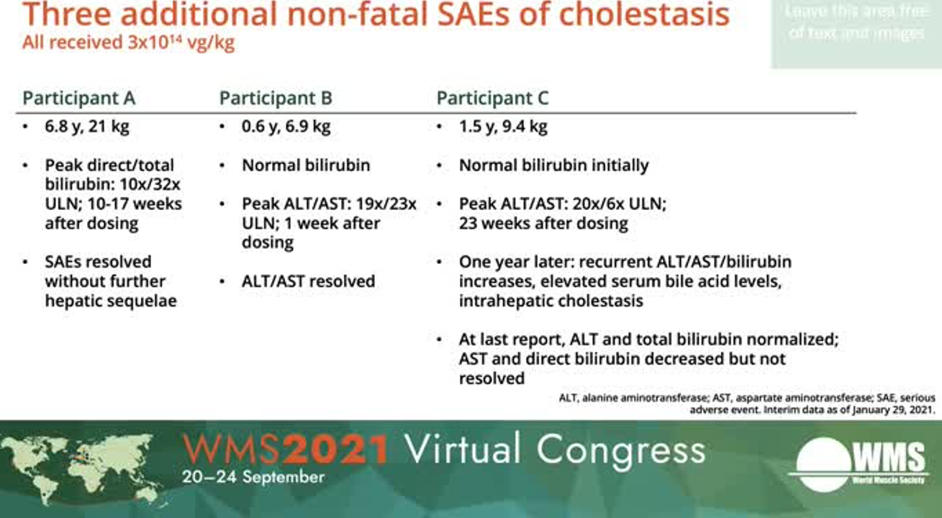

Slide 16
Conclusion
AAV can be very effective in delivering the gene of interest to muscle or brain, but a lot is trapped in the liver, while “in transit”
A degree of transient liver damage is very common after AAV gene therapy
Administration of high doses of steroids can mitigate the damage
However in people with MTM1 there can be a degree of pre-existing liver involvement. This had not been previously appreciated in full
The study participants who died after dosing were the older, hence received the greatest viral vector load
These patients had clinical evidence of liver involvement (cholestasis) prior to treatment
Different strategies to minimize this adverse events under consideration

Slide 17
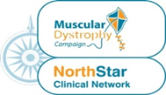
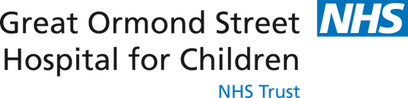


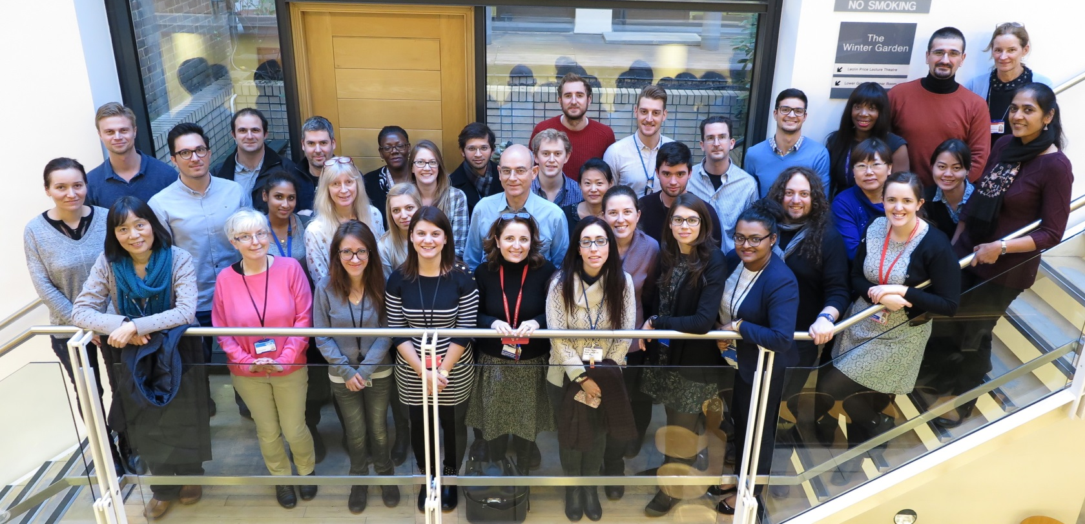
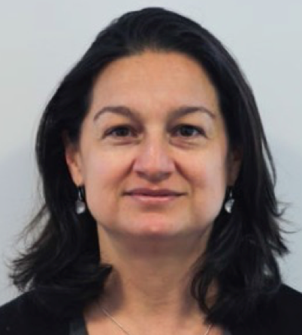
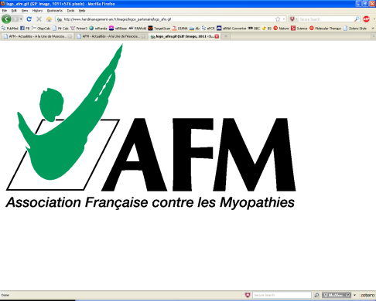
Acknowledgment
Clinical and research team at
GOSH/ ICH

