Slide 1
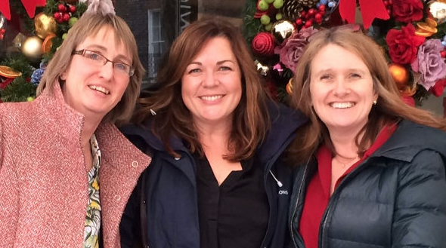


Slide 2


Slide 3
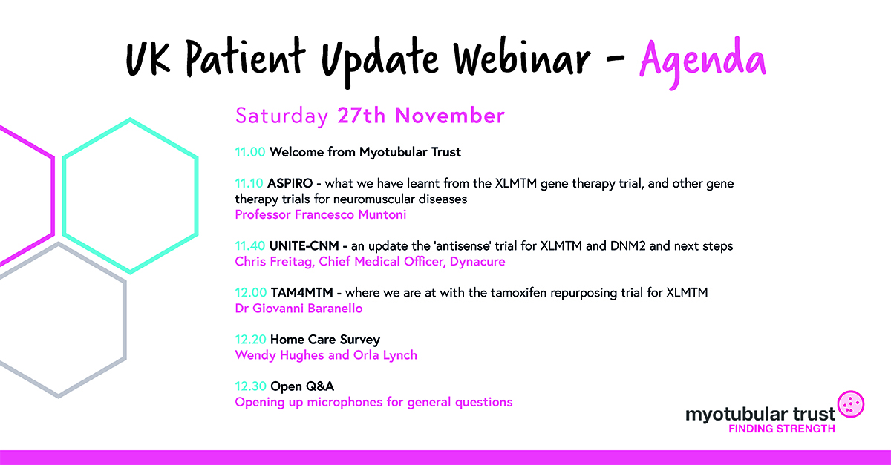

Slide 4
Summary of current trials

Slide 5
Trials in the pipeline
ASPIRO a gene therapy, sponsored by Astellas Therapeutics (was Audentes Therapeutics)
UNITE-CNM an antisense therapy, sponsored by Dynacure
TAM4MTM repurposing tamoxifen, an academic led study
A product in clinical trial is ‘an investigational product’ not a treatment
The first approved treatment for our condition might be one of these three products… and might be something else…

Slide 6
Stages – an overview
Clinical trial
‘Sponsored’ by a pharmaceutical company or academic institution
Approved and oversight by regulators – MHRA in the UK
Proof of concept
Pre-clinical research
Scientist and laboratory based
Marketing authorisation
MAA in Europe, BLA in USA
Country’s regulators decide – EMA, FDA or country specific (MHRA in the UK)
Sign off by those who buy medicines on behalf of a population
Reimbursement
SMC for Scotland, NICE for England & Wales

Slide 7

Clinical trials – prove it works
Is it safe
Is the balance right
Is it effective

Slide 8
Clinical trials – prove it works
Is it safe
Is the balance right
Is it effective
Regulators decide
The right facts are being sought
The best ‘outcome measures’ are being measured
The company
Follow a very precise protocol
Present results to regulators
The Regulators
Grant a marketing authorisation
……a drug license

Slide 10
Role of patient organisation funding
Focused charity funding specific proof of principle ideas
The initial £100Ks
Larger national charities
The many £100Ks
Biotech companies
The £Millions

Slide 11
Role of patient organisation funding
Focused charity funding specific proof of principle ideas
The initial £100Ks
Larger national charities
The many £100Ks
Biotech companies
The £Millions
Human clinical trials

Slide 12
Gene therapy timeline
Grant to Ana Buj Bello £104,000
AFM & MDA grant of $783,000
Audentes Therapeutics $30M fund
2008
18 months later
18 months later again

Slide 13
Ripple effect

Slide 14
Thank you all!

